Slide 1
Unit Testing

Slide 2
Agenda
Best Practices
Atomicity
No loops & No conditional logic
Exception catching
Code Coverage checks
Informative Assertion messages
Parameterize test cases
Naming Conventions
Miscellaneous

Slide 3

Best Practices
Atomicity:
There should not be any return type for the method.
The method should only specify whether it is pass or fail.
Don’t print anything out in unit tests

Slide 4
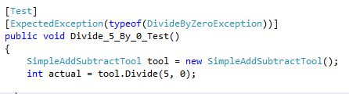
Best Practices
No loops & No conditional logic :
There should not be any conditional logic(i.e.., If Statements or Switch cases) as well as Loops.
Exception Handling :
Only when exception is expected.

Slide 5
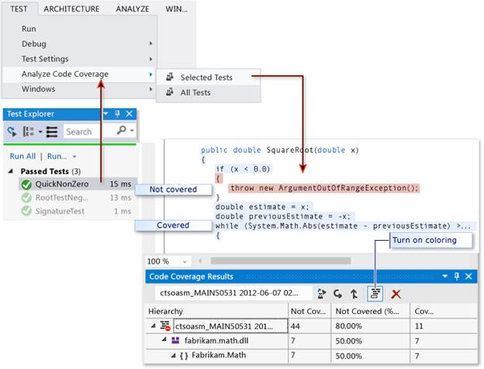
Best Practices
Code Coverage Checks :
We Should test the code as such we can cover the most number of scenarios possible.

Slide 6
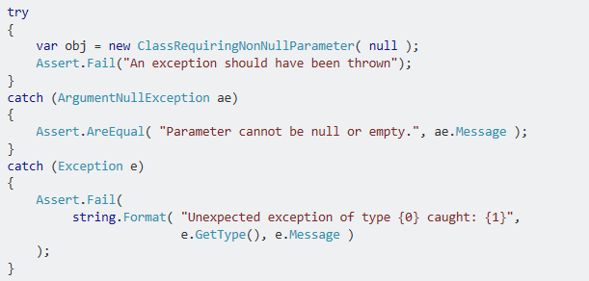
Best Practices
Informative Assertion Messages:
It is done for better code documentation and failures.
We can display the reason for the failure of a method.

Slide 7
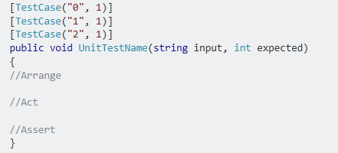
Best Practices
Parameterize Test Cases :
Some tests are required to be repeated for different input parameters.
One way to achieve this is by decorating the test method with TestCaseAttribute.
TestCaseAttribute serves the dual purpose of marking a method with parameters as a test method and providing inline data to be used when invoking that method.
And the example is as follows:

Slide 8
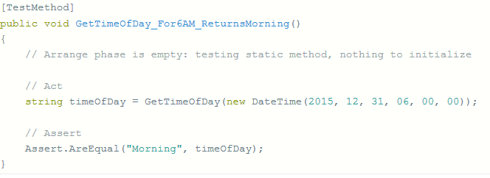
Best Practices
Naming Conventions :
You should write readable code because it helps others to read your code.
Naming thing is one of the hardest job we have as a software developer.
Because we spend a lot of time naming things, there are so many things to name properties, methods, classes, files, projects etc.

Slide 9
Best Practices
Miscellaneous :
Always Write Isolated Test Cases.
Structure All Test Cases.
No test logic in production code.
Test Case Modularity: Separation per business module.
Unit test case should be separated based on purpose, frequency, time and action.
Different execution order but should have same results .

Slide 10


